Slide 1
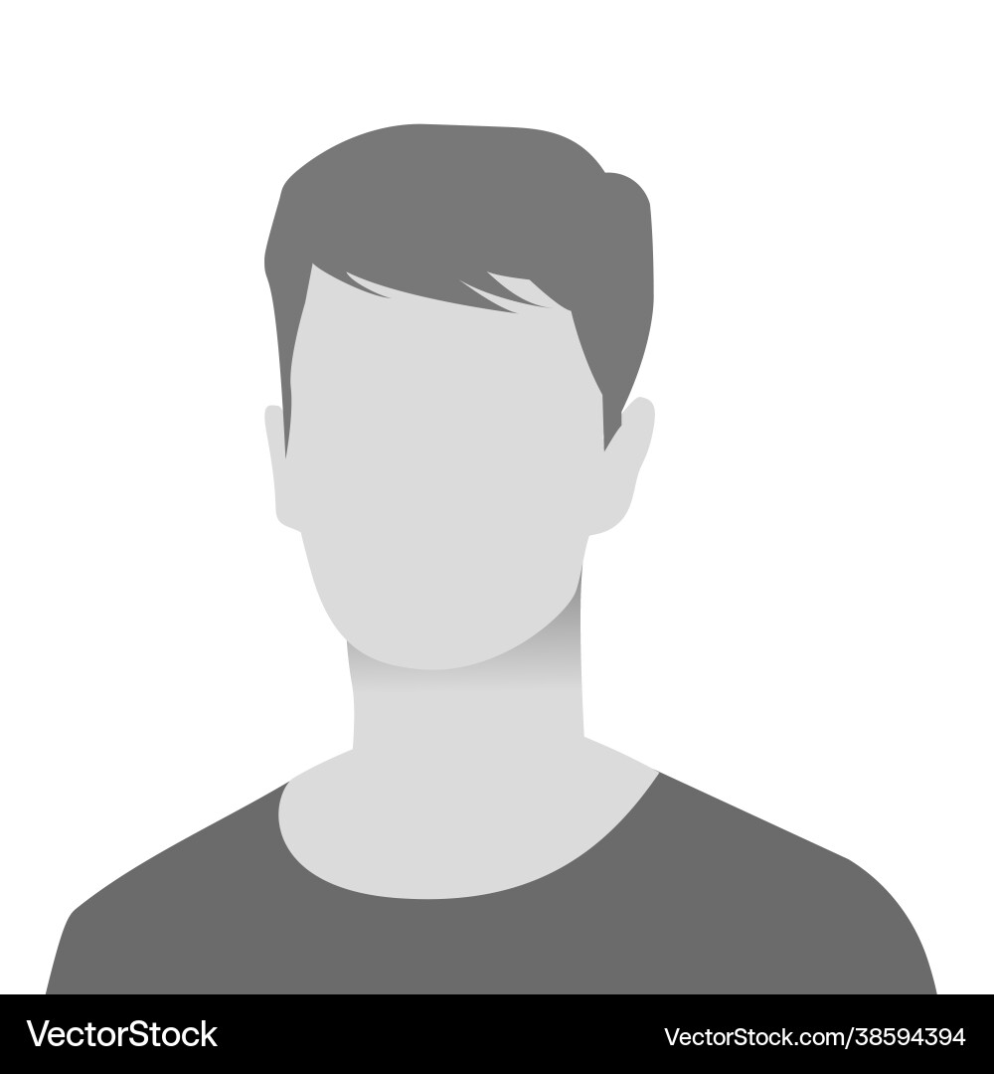
Americas MTT Town Hall
Month 2024
Hosted by: Peter De Tender
Member of the Americas Culture Club

Slide 2
Agenda
Missing Sync Week Too? – Peter De Tender
MTT Anniversaries – Peter De Tender
Rhythm Of The Business – Americas Managers
Executive Immersion Experience – Chris Henley/Elias Estevao
ISC2 – John Lewis
DEI – Bobbie Russell
Copiloted ILT – Elias Estevao
Holiday Memories – Culture Club
Open Mic / Q & A – MTT Americas
Notes:
<5> Missing Sync Week Too? – Peter De Tender
<5> Anniversaries and Welcomies – Peter De Tender
<25> Rhythm Of The Business – Americas Managers
<10> Executive Immersion Experience – Chris Henley/Elias Estevao
<10> ISC2 – John Lewis
<10>DEI – Bobbie Russell
<10> Copiloted ILT – Elias Estevao
<5> MTT Holiday Memories – Peter De Tender
<10> Open Mic / Q & A – MTT Americas

Slide 3
Missing Sync Week Too?
November 2024
Peter De Tender
Notes:
8 minutes

Slide 4
Anniversaries
November 2024
Peter De Tender
Notes:
8 minutes

Slide 5
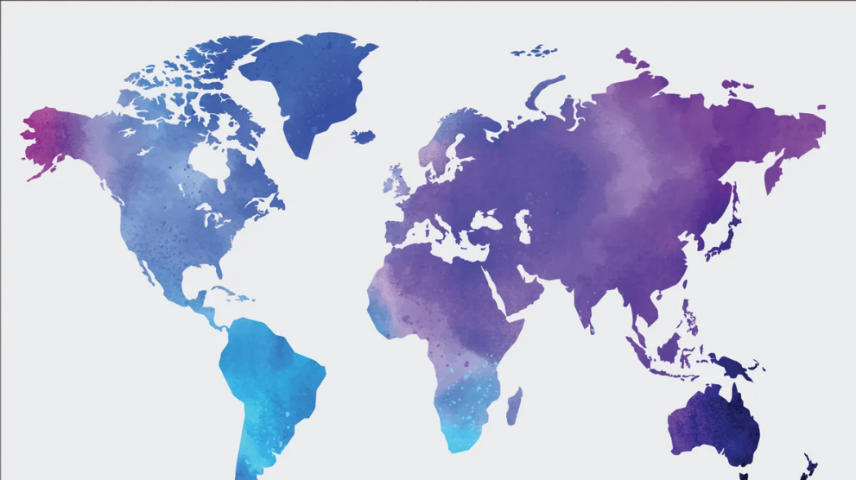


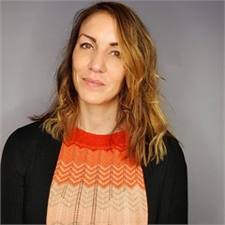
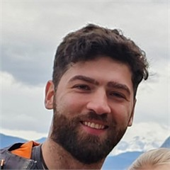
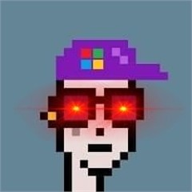
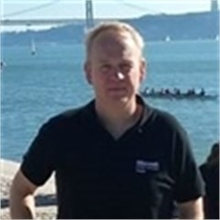
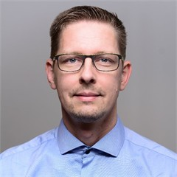
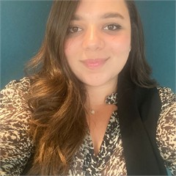
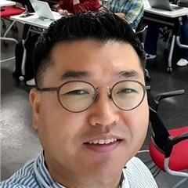
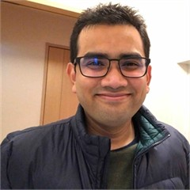
5-year anniversary
10-year anniversary

Slide 6
Rhythm Of Business
November 2024
Americas MTT Managers
Notes:
8 minutes

Slide 7
Executive Immersion Experience
November 2024
Chris Henley – Elias Estevao
Notes:
8 minutes

Slide 8
ISC2
November 2024
John Lewis
Notes:
8 minutes

Slide 9

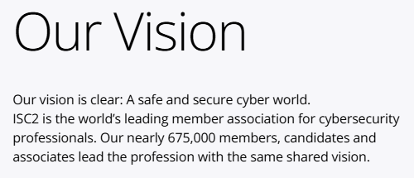
International Information System Security Certification Consortium
https://www.isc2.org/about
Notes:
https://www.isc2.org/about

Slide 10
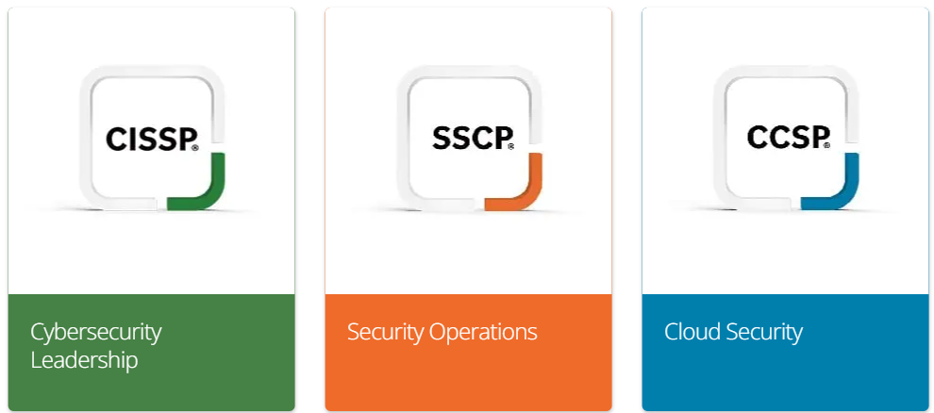
ISC2 - Certifications
https://www.isc2.org/certifications
Notes:
https://www.isc2.org/certifications

Slide 11
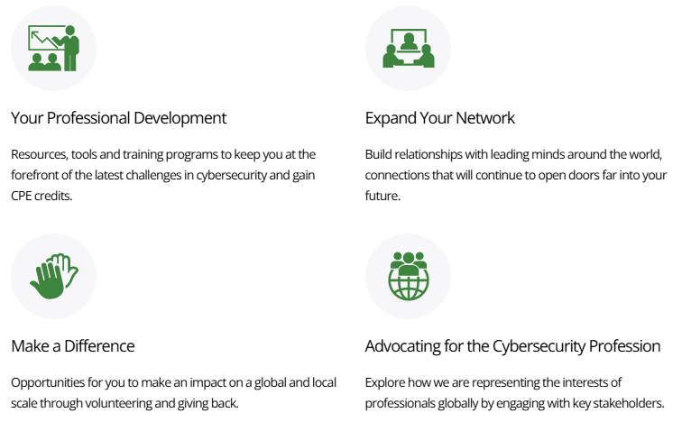
ISC2 – Membership Benefits
Discounts on:
Industry conferences like RSA and Blackhat
ISC2 Conferences – both the Secure Summits & our Global Congress Conference
50% off select CBK Books, Study Guides, and Practice Tests by Wiley
30% off select CBK Books from CRC Press
Various courses, subscriptions, databases, reports, and programs.
https://www.isc2.org/landing/member-stories
Notes:
https://www.isc2.org/landing/member-stories

Slide 12

ISC2 – One Million Certified in Cybersecurity
https://www.isc2.org/landing/1mcc
Notes:
https://www.isc2.org/landing/1mcc

Slide 13
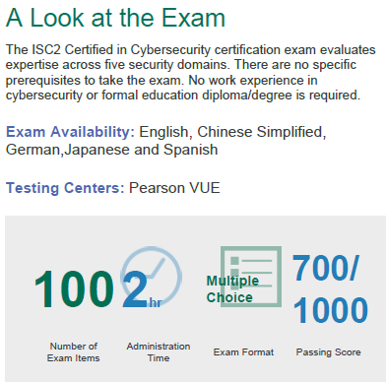
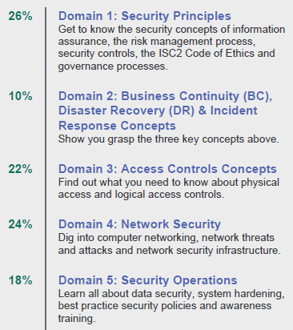
ISC2 – Certified in Cybersecurity
https://www.isc2.org/certifications/cc
Notes:
https://www.isc2.org/certifications/cc

Slide 14
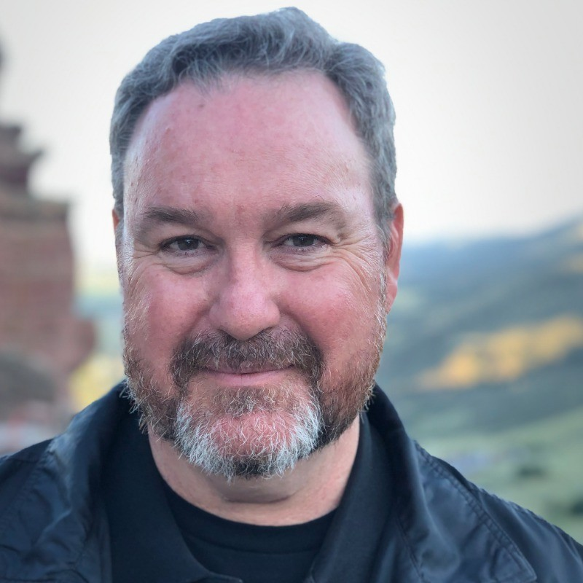
ISC2 - Questions
John Lewis, MTT
LewisJohn@Microsoft.com
https://www.linkedin.com/in/johnlewisprofile
https://www.isc2.org
Notes:
John Lewis, MTT
LewisJohn@Microsoft.com
https://www.linkedin.com/in/johnlewisprofile
https://www.isc2.org

Slide 15
DEI
November 2024
Bobbie Russell
Notes:
8 minutes

Slide 16
Copiloted ILT
November 2024
Elias Estevao
Notes:
8 minutes

Slide 17
Culture Club – Holiday Memories Photo Album
November 2024
Peter De Tender
Notes:
8 minutes

Slide 18
Open Mic / Q & A
November 2024
Americas MTTs
Notes:
8 minutes

Slide 19


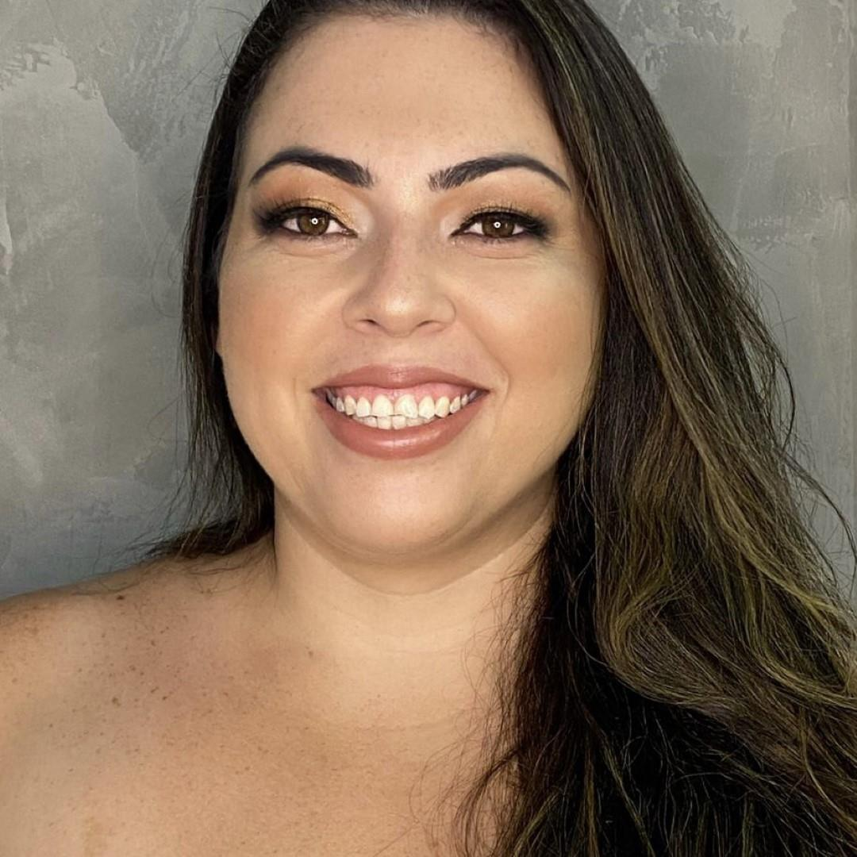
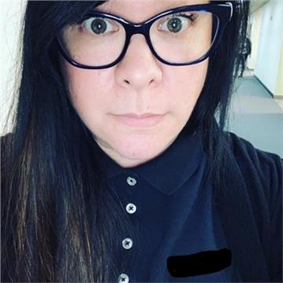
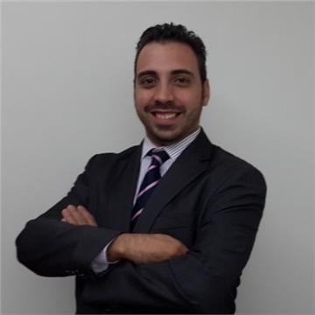
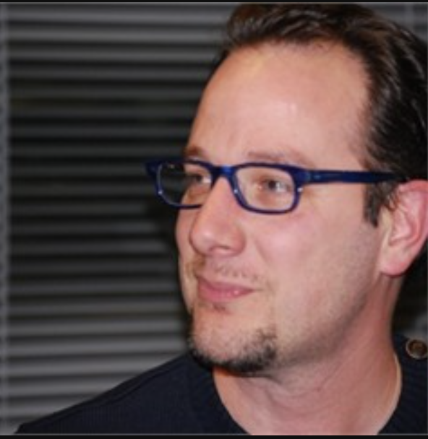
Jaqueline
Sarah
Renato
Peter
Notes:
Susanne Tedrick
Jaqueline Ramos
Sarah Kong
Abu Zobayer
Renato Strianese
Stephen Deming
Tom Hatty

Slide 20
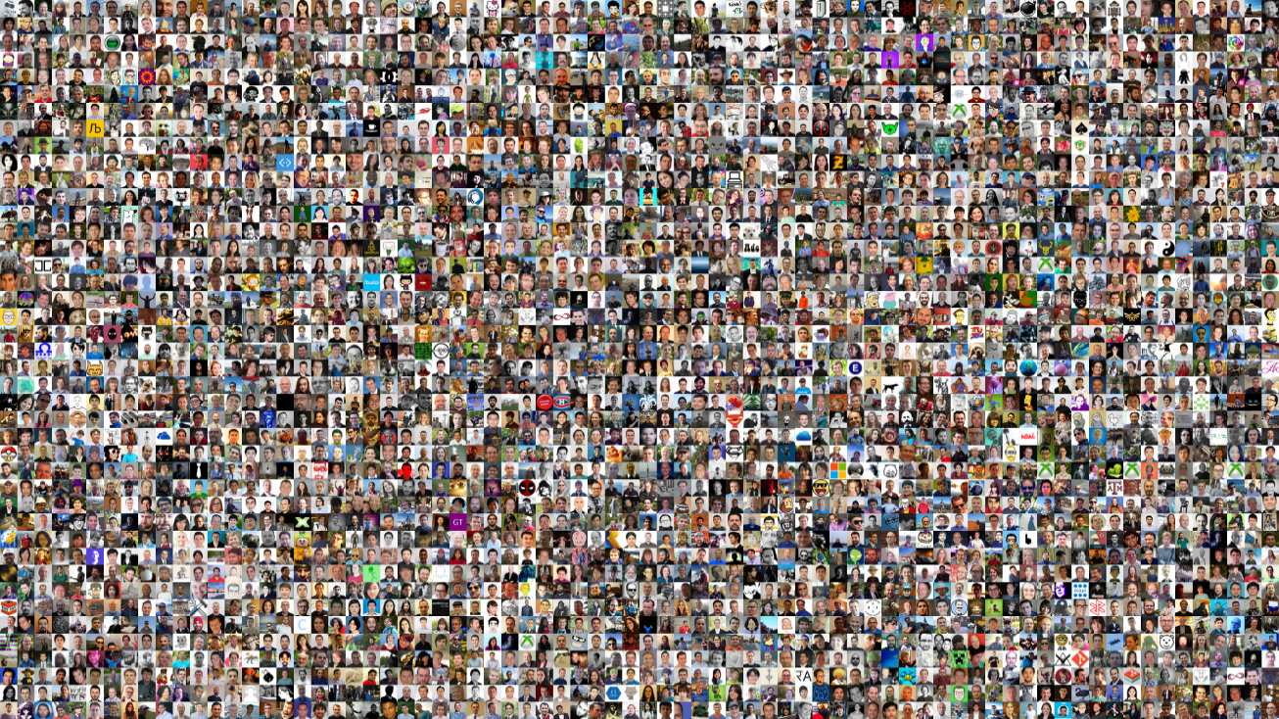

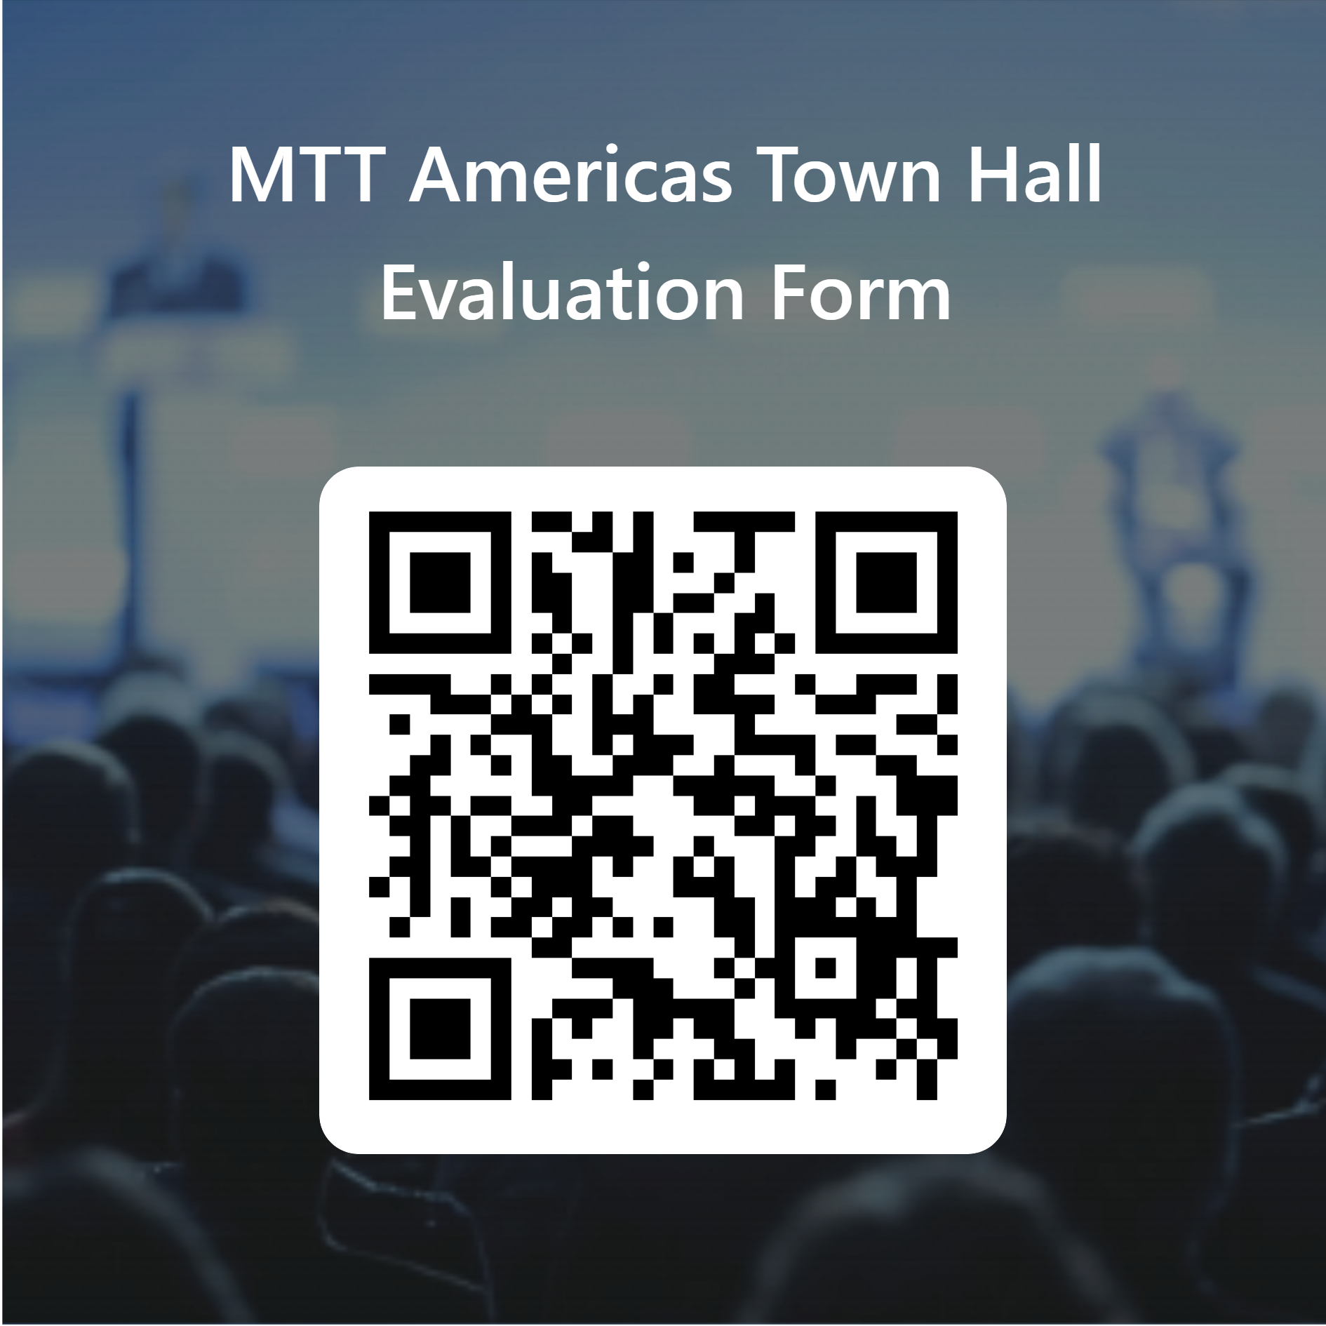
What do you think?
aka.ms/townhallmttamerica

Slide 21

Thank you
Thank you!
Merci
አመሰግናለሁ
Grazie
धन्यवाद
ᠪᠠᠶᠠᠷᠯᠠᠯ᠎ᠠ᠃
ধন্যবাদ

